Slide 1
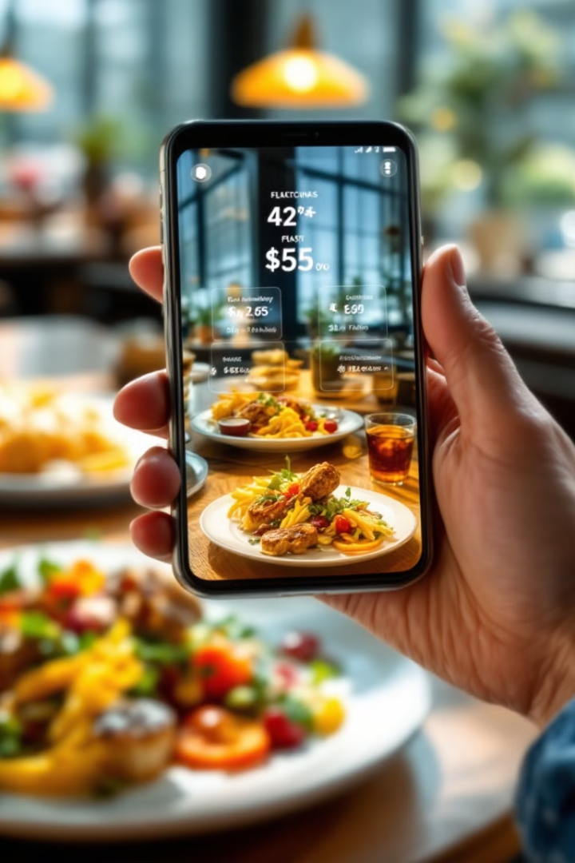
AI-Powered Food Analysis for Dietary Restrictions
Our innovative app helps people with dietary restrictions make informed food choices through real-time analysis of food images.
Using advanced AI and computer vision technology, we deliver instant nutritional insights right when users need them most.
By team dr. minions

Slide 2
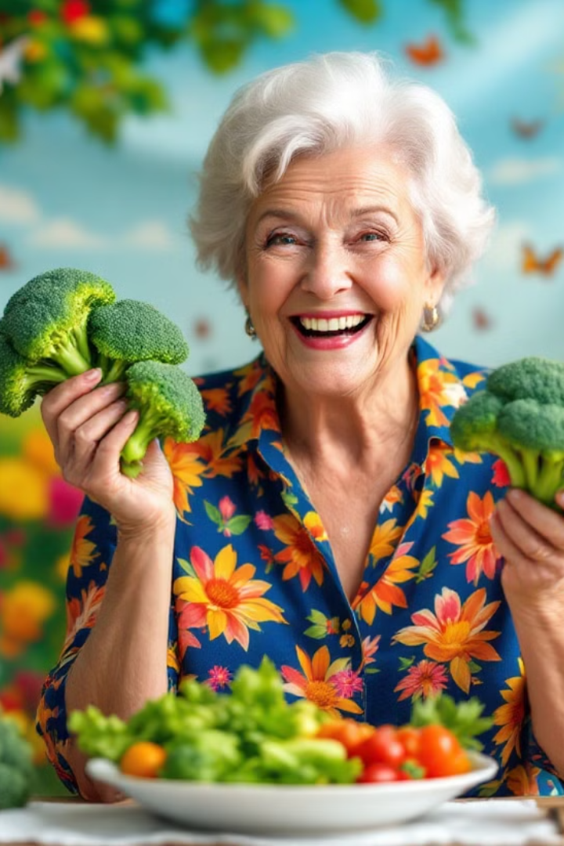
Impact and Benefits
Safety First
Informed Choices
Users with severe allergies can quickly identify potentially dangerous ingredients before consuming food.
Instant access to complete nutritional profiles helps maintain dietary requirements with confidence.
Better Health Outcomes
Consistent dietary compliance leads to improved health markers and enhanced quality of life.

Slide 3



Technology Behind the App
Enhanced Dataset
We refined a Hugging Face dataset to significantly improve recognition accuracy across diverse food types and presentations.
YOLOv8 Integration
Our implementation of YOLOv8 enables efficient detection with minimal processing delay on standard smartphone hardware.
Real-Time Analysis
Users get instant nutritional breakdowns with allergen warnings within seconds of capturing an image.

Slide 4



Future Improvements
Personalized Experience
1
Complete integration with medical records and preferences
Portion Analysis
2
Advanced algorithms to analyze food quantity
Mass Estimation
3
Surface area calculations using density ratios
Our next updates will transform simple food identification into comprehensive nutritional analysis with personalized health insights.

